Slide 1
ENVS 410/510: Data analysis and visualization
Dr. Lauren Hallett
Dr. Andrew Muehleisen
Lina Aoyama

Slide 2


Slide 3
Overall goals
Your learning
Understand and design steps that link raw data to communicated findings
Interpret raw data as well as figures presented in scientific papers/the media
Gain exposure to R and comfort with programming
Your experience
Resources to empower you to learn and explore
Flexibility to adapt to challenging times
Community to support and develop together

Slide 4
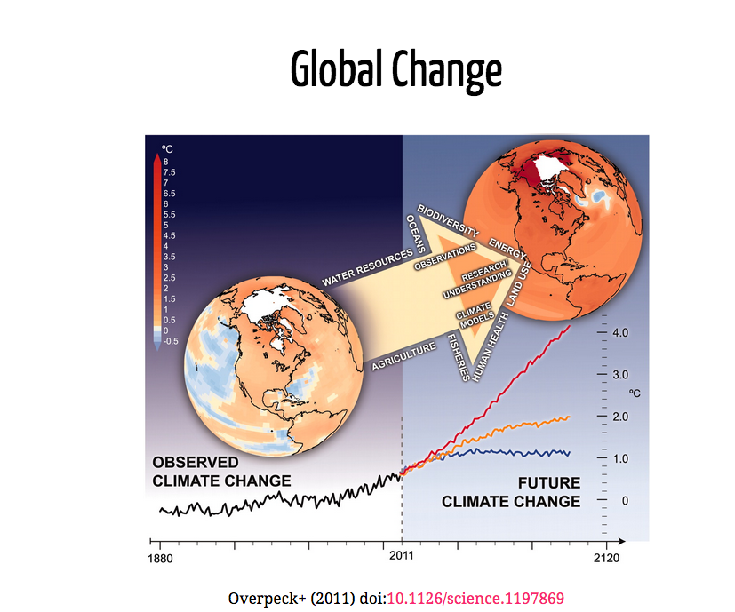

Slide 5
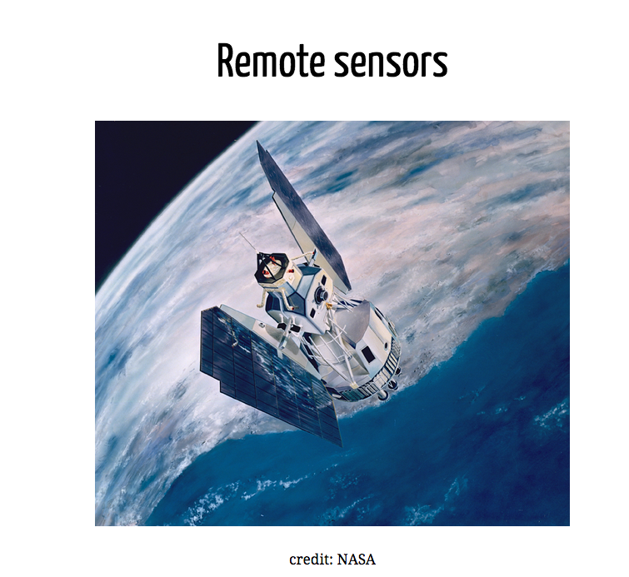

Slide 6
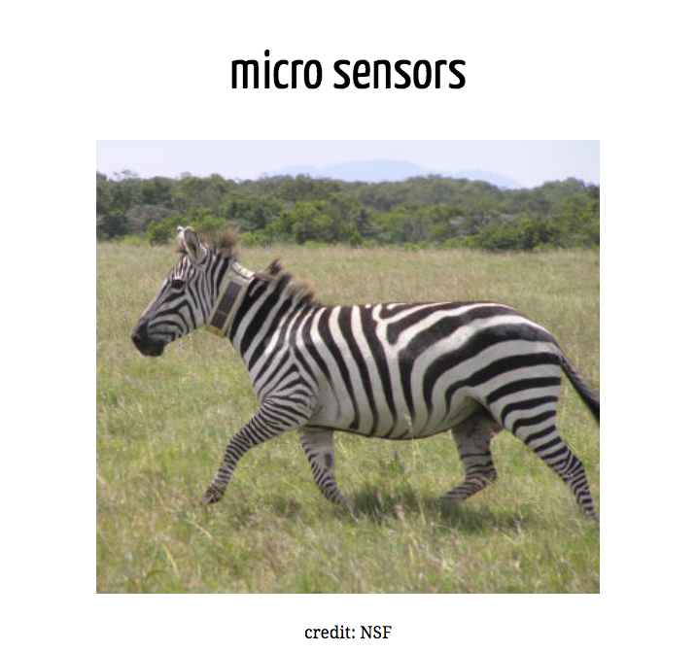

Slide 7
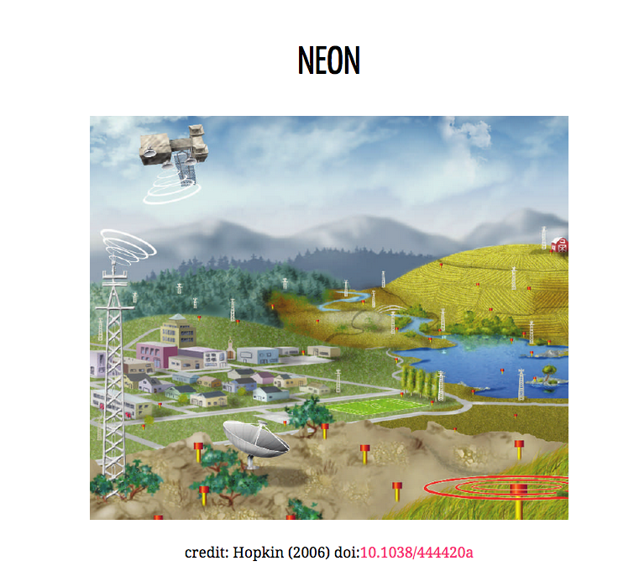

Slide 8
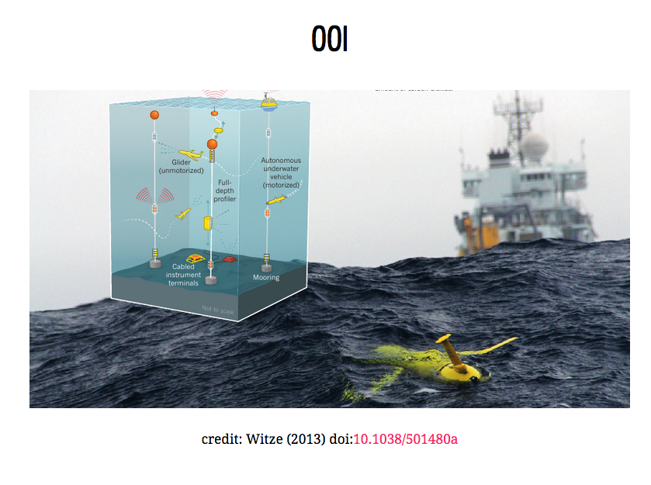

Slide 9


Slide 10
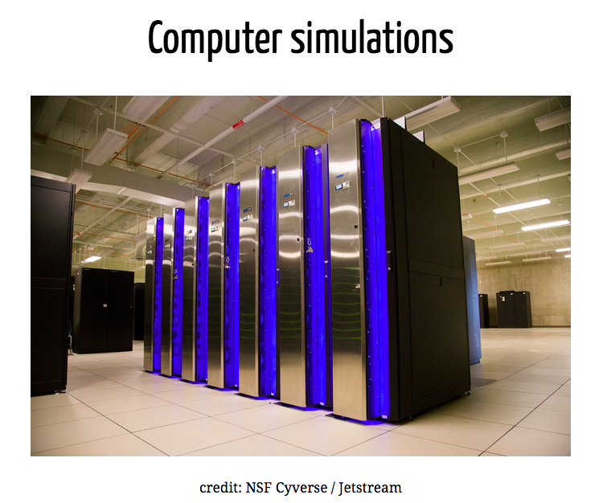

Slide 11
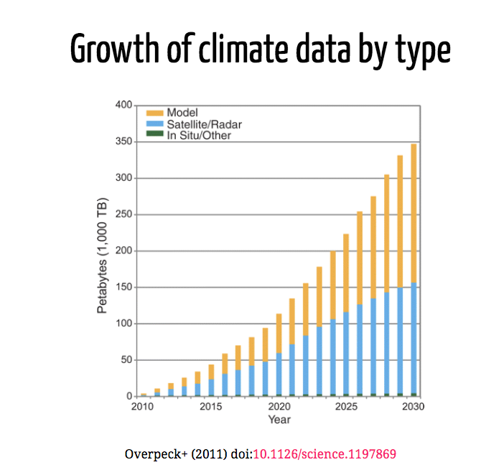

Slide 12
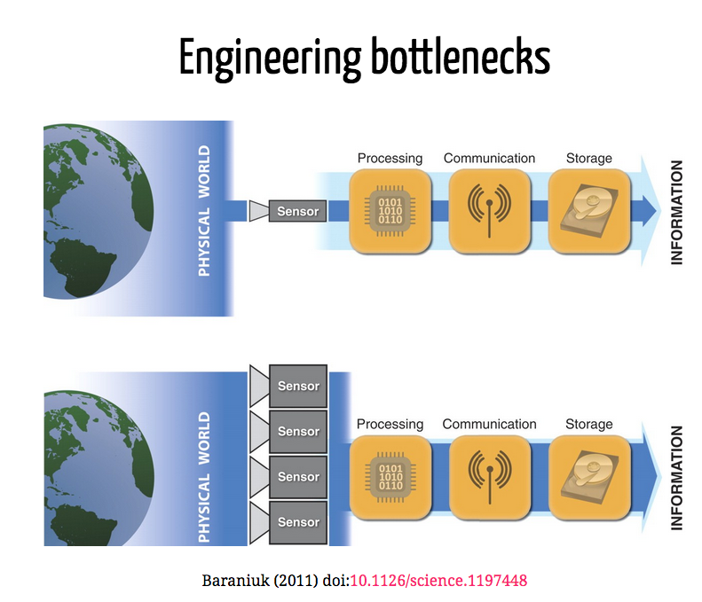

Slide 13
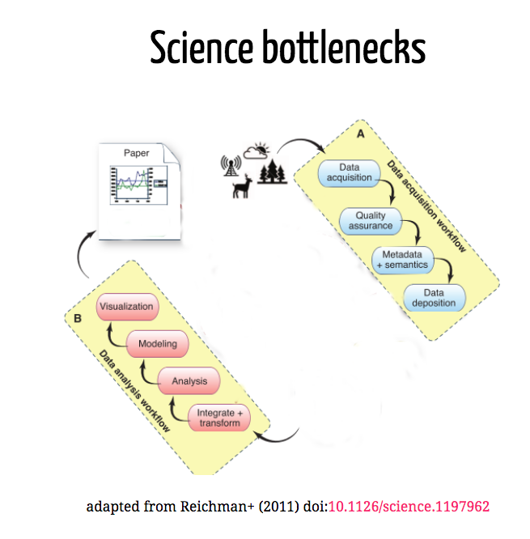

Slide 14
Our focus is on these Science bottlenecks

Slide 15
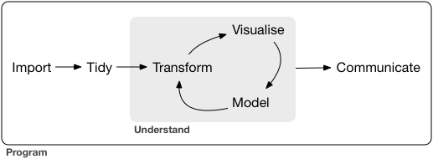
Course content: Developing workflows for the data life cycle
Wickham and Grolemund R for Data Science

Slide 16
This course:
Real data, real tools
Things will break
Things will change

Slide 17
This course:
Some things will be in keeping with good pedagogy:
We’ll start with graphs first
Short videos and active learning
Some things aren’t:
We’ll jump forward and back at times
Starting at the deep end

Slide 18
How we’ll do it:
Different modules that transition from demonstration to independent coding
Modules can be completed fully asynchronously, but we recommend you watch the videos and then finish the code with us in class
Frequent practice via four problem sets
An independent project in which you go from raw data to a reproducible final report
A free online text to help you along! https://r4ds.had.co.nz/

Slide 19
Language: Why R?
Scripted languages allow reproducibility
Not about technical attributes
Pick your language based on what people in your area speak/code
Rstudio, Rmarkdown and other tools for communication and sharing
A great open-source community (on that note - thanks to Carl Boettiger and Jenny Bryan for many of todays slides)

Slide 20
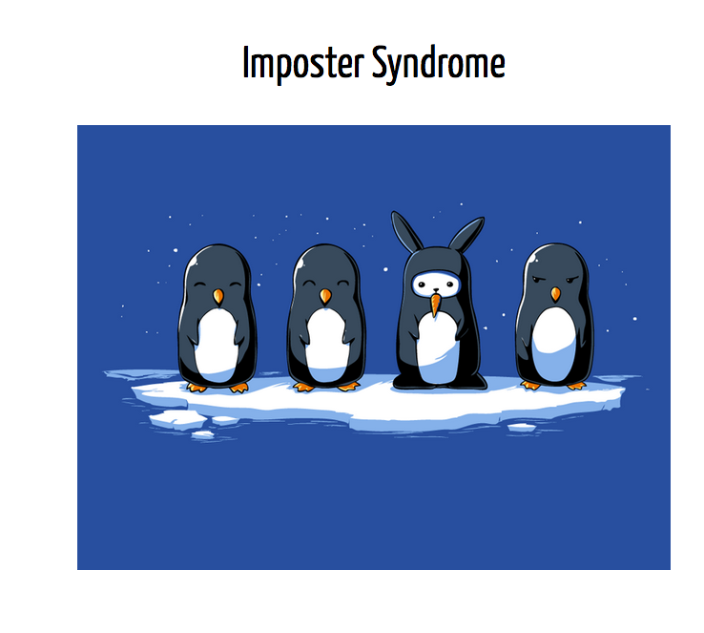

Slide 21
Before the first class
Check out materials in the “START HERE” module to learn the nuts and bolts of course structure and introduce yourself
Watch the videos associated with the “Week 1” module
Follow the computer set-up instructions to install R and RStudio

